Slide 1

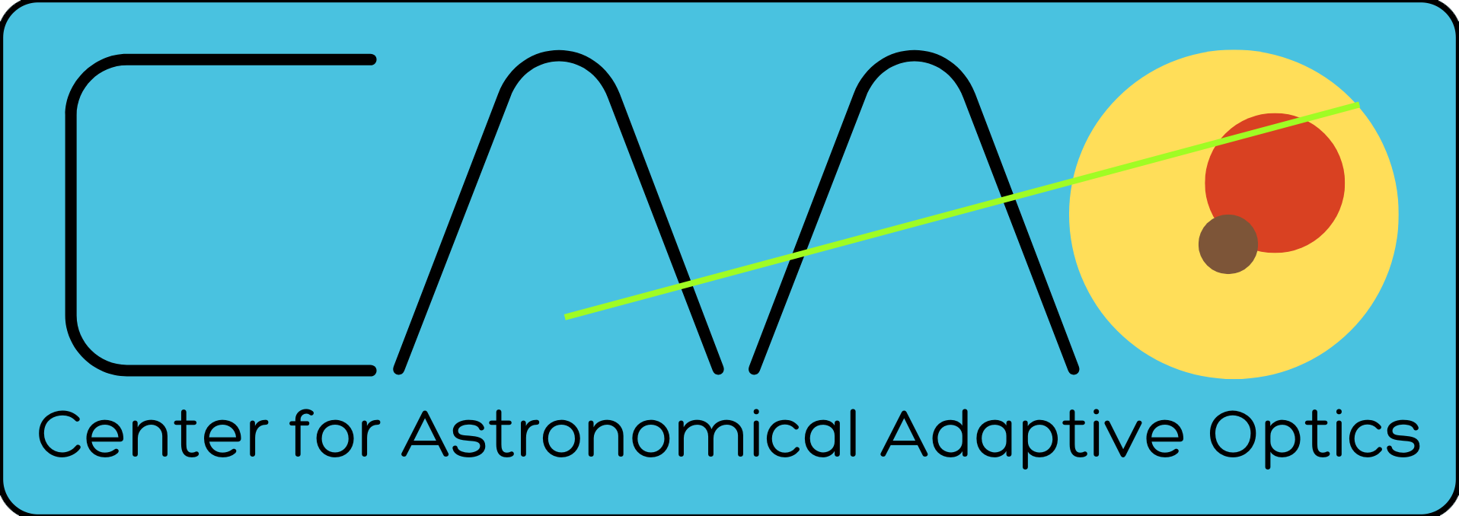
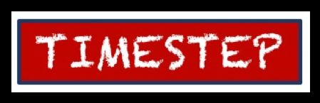



TimeStep Internship Skills Education
28 March 2022
Part One: Introduction
to
&
Jess Johnson
Steward Observatory
Git & Github logos used with permission

Slide 2
TimeStep Internship Skills Education
28 March 2022 Jess Johnson Steward Observatory
Introduction

Slide 3
TimeStep Internship Skills Education
28 March 2022 Jess Johnson Steward Observatory
Introduction
From ‘Git Magic’
“Git is a version control Swiss army knife. A reliable versatile multipurpose revision control tool whose extraordinary flexibility makes it tricky to learn, let alone master.
As Arthur C. Clarke observed, any sufficiently advanced technology is indistinguishable from magic. This is a great way to approach Git: newbies can ignore its inner workings and view Git as a gizmo that can amaze friends and infuriate enemies with its wondrous abilities..”
From Ben Lynn’s ‘Git Magic’.

Slide 4
TimeStep Internship Skills Education
28 March 2022 Jess Johnson Steward Observatory
Introduction
From ‘The GIT Parable’
“Git is a simple, but extremely powerful system. Most people try to teach Git by demonstrating a few dozen commands and then yelling ‘tadaaaaa’. I believe this method is flawed. Such a treatment may leave you with the ability to use Git to perform simple tasks, but the Git commands will still seem like magical incantations. Doing anything out of the ordinary will be terrifying. Until you understand the concepts on which Git is built, you’ll feel like a stranger in a foreign land.”
From Tom Preston-Werner’s ‘The Git Parable’.

Slide 5
TimeStep Internship Skills Education
28 March 2022 Jess Johnson Steward Observatory
What is Git?

Slide 6
TimeStep Internship Skills Education
28 March 2022 Jess Johnson Steward Observatory
What is Git?

Slide 7
TimeStep Internship Skills Education
28 March 2022 Jess Johnson Steward Observatory
What is Git?
What is Version Control?
Version control is a system that records changes to a file,
or a set of files,
over time,
so that you can recall specific changes later.

Slide 8
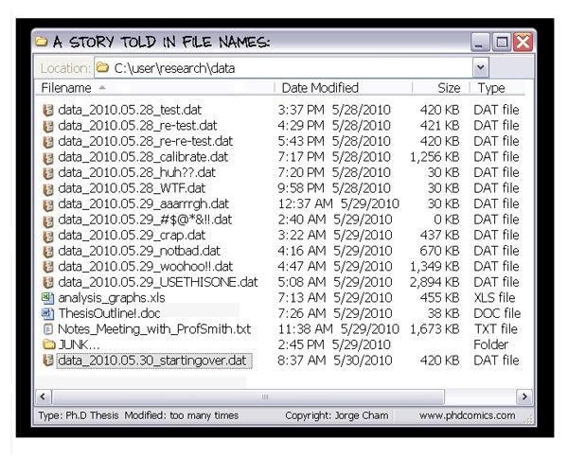
TimeStep Internship Skills Education
28 March 2022 Jess Johnson Steward Observatory
What is Version Control?
Everyone has used some form of version control, usually a kind of an ad hoc, ‘keep saving copies every time you make a change to the file’ version control. This is a form of Local Version Control.
Files are easily misplaced or lost
Difficult to keep track of changes
Error prone – easy to accidently overwrite
Collaboration is virtually impossible
Image from Ph.D. Comics by Jorge Cham

Slide 9
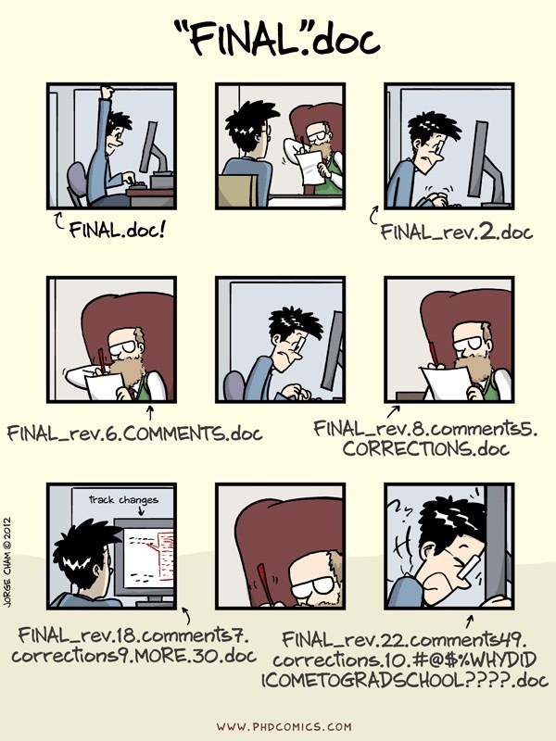
TimeStep Internship Skills Education
28 March 2022 Jess Johnson Steward Observatory
What is Version Control?
Image from Ph.D. Comics by Jorge Cham

Slide 10
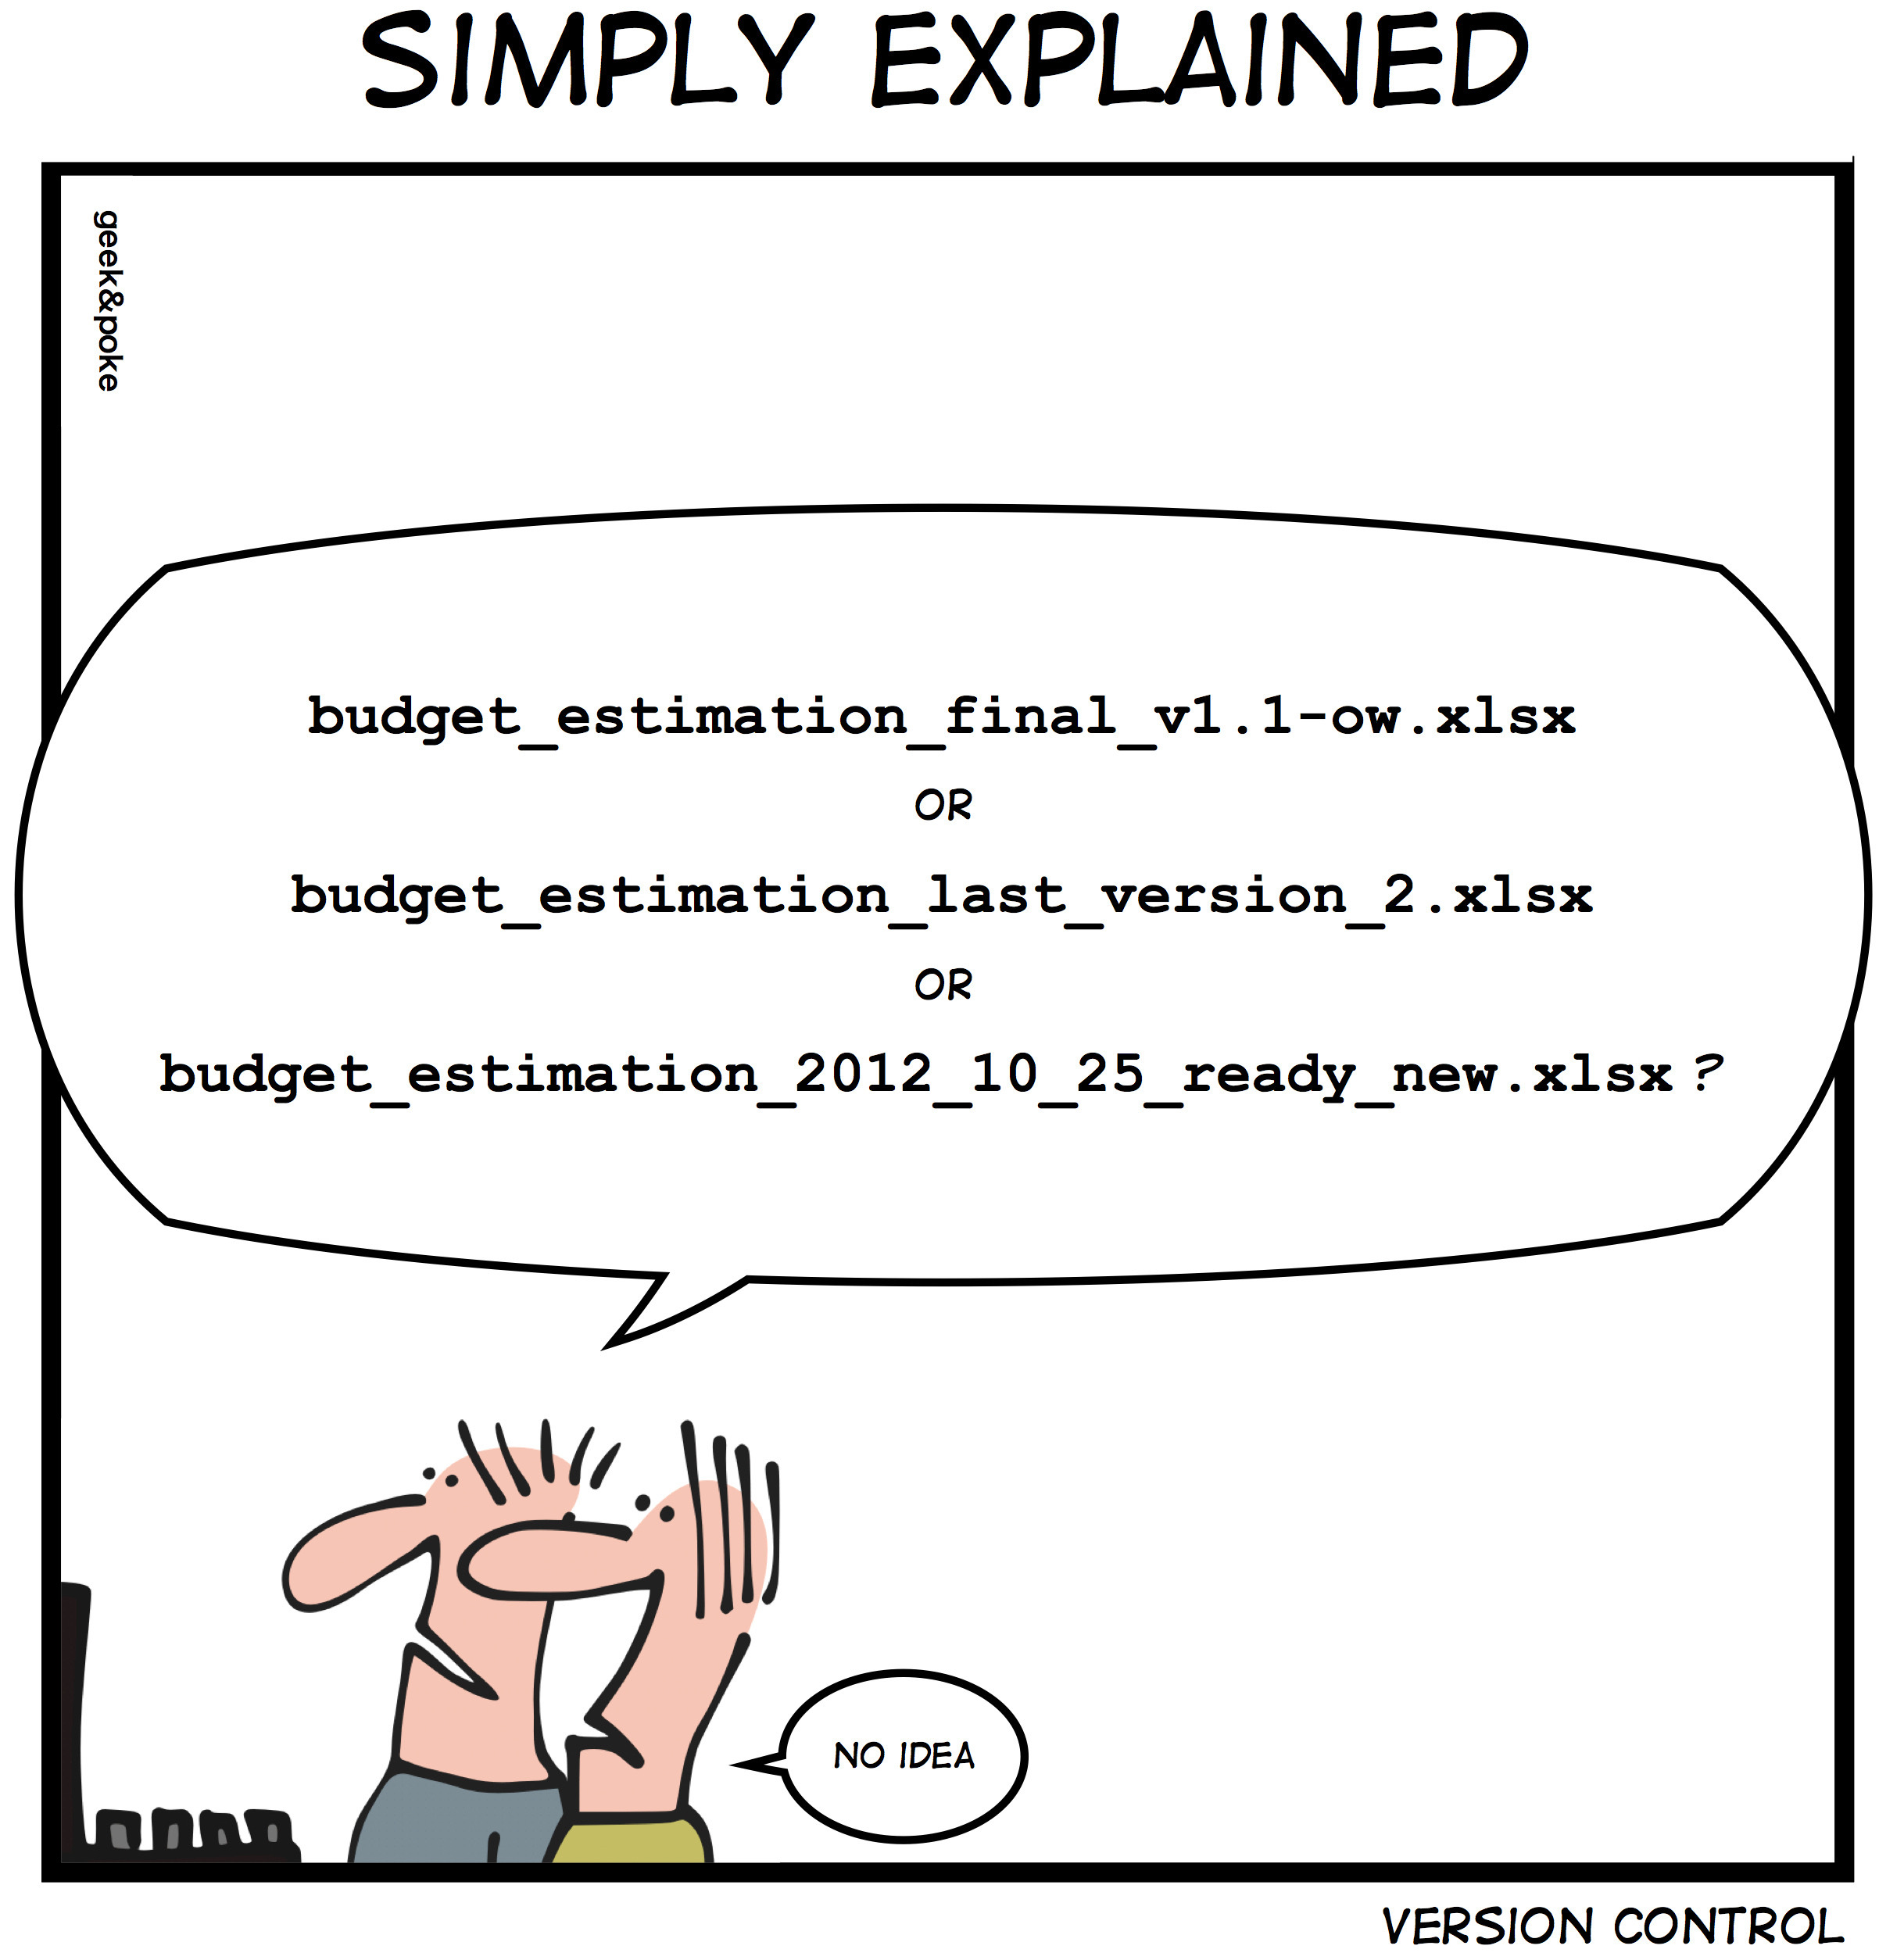
TimeStep Internship Skills Education
28 March 2022 Jess Johnson Steward Observatory
What is Version Control?
Image from Ph.D. Comics by Jorge Cham

Slide 11
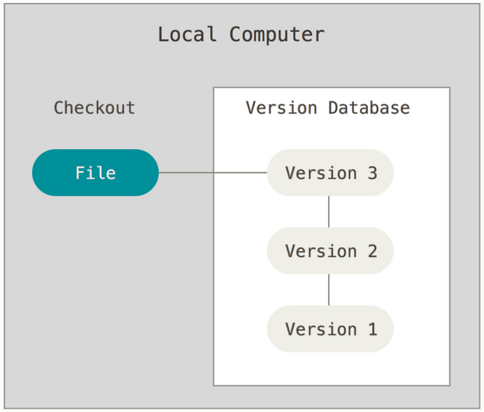
TimeStep Internship Skills Education
28 March 2022 Jess Johnson Steward Observatory
What is Version Control?
The next step up from this is Local Version Revision Control. Instead of saving entire files, only the revisions to the files are saved as differences (patch sets), kept in a Version Database.
Saves a BUNCH of storage space
Can examine changes to a file easily
Localized, so collaboration is still difficult
Image from Chacon & Straub’s ‘Pro Git’.

Slide 12
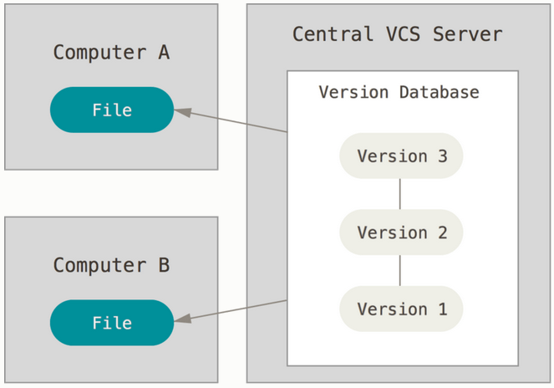
TimeStep Internship Skills Education
28 March 2022 Jess Johnson Steward Observatory
What is Version Control?
To address collaboration, Centralized Version Control Systems were developed. A single server contains the revision control system, and clients check out files and revise them and submit their changes.
Everyone can see what everyone is doing
Files are shared from a centralized location
Administrator has fine-grained control
Single point of failure… the server
Image from Chacon & Straub’s ‘Pro Git’.

Slide 13
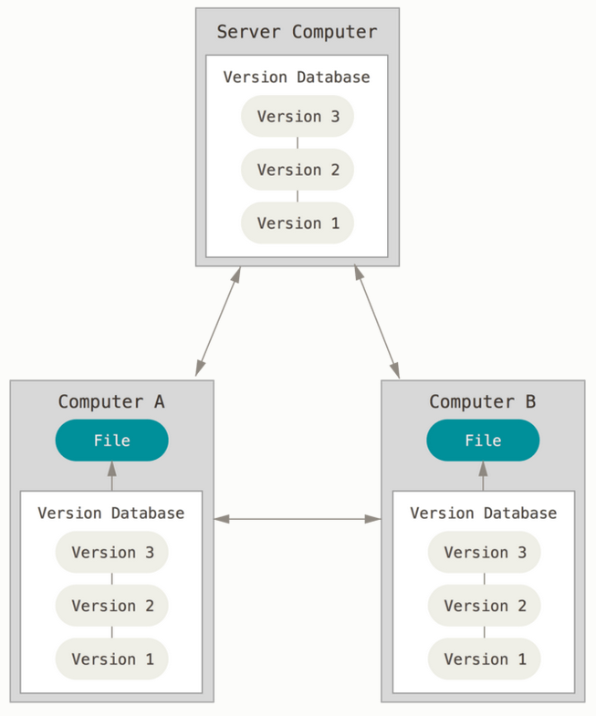
TimeStep Internship Skills Education
28 March 2022 Jess Johnson Steward Observatory
What is Version Control?
The final evolution of this, as of now, is the Distributed Version Control System. In this system, clients don’t just check out a snapshot of a file, they fully mirror the entire repository of changes.
All the benefits of previous forms of VCS
Database redundancy
Supports multiple repositories
Multiple group collaborations
Can be difficult to set up collaborator access
Image from Chacon & Straub’s ‘Pro Git’.

Slide 14
TimeStep Internship Skills Education
28 March 2022 Jess Johnson Steward Observatory
What is Git?

Slide 15


TimeStep Internship Skills Education
28 March 2022 Jess Johnson Steward Observatory
What is Git?
Git is a Distributed Version Control System. It was created to keep track of changes being made by multiple contributors in the early years of the development of Linux… largely by the same guy who created Linux… Linus Torvalds.
Git evolved from BitKeeper:
Faster
Simpler
Large Projects
Fully Distributed

Slide 16
TimeStep Internship Skills Education
28 March 2022 Jess Johnson Steward Observatory
What is Git?
Local Operations
This is what makes Git stand out from other VCSs. Because your Git installation mirrors repositories, the majority of operations on files have no network latency, as those operations are taking place on your own system. It also means that you can work without a network connection, say, on an airplane, or when Cox goes down for the evening.
Integrity
Git makes fundamental use of SHA-1 hash checksums. It is impossible to fool it (or at least without a huge amount of effort). No file or directory can be changed without Git knowing it. This applies both to intentional deception attempts as well as network transfer file corruption. Everything in Git’s database is stored and referenced by checksums.
Snapshots, not Differences
Most VCSs use Δ-based version control… that is, they store information as a list of file-based changes. Git can be best conceptualized as a ‘mini-filesystem’, which is updated every time you commit a change. It ‘snapshots’ the result of the commit… and then stores those snapshots, extracting whatever it needs by comparing snapshots.

Slide 17
TimeStep Internship Skills Education
28 March 2022 Jess Johnson Steward Observatory
What is Git?
Only Adds Data
Nearly all operations in Git add data to the database. It’s (almost) impossible to erase data in anyway, which both protects the systems integrity AND makes it difficult to truly screw anything up.
Supports Non-Linear Workflows
In non-linear workflow, workflow is split into multiple branches each of which is dealt with separately and independently from each other.

Slide 18
TimeStep Internship Skills Education
28 March 2022 Jess Johnson Steward Observatory
What is Github?

Slide 19
TimeStep Internship Skills Education
28 March 2022 Jess Johnson Steward Observatory
What is GitHub?
So, Git is a Distributed Version Control System that supports non-linear workflows and operates mostly locally by creating and adding snapshots of its checksum protected mini-filesystem.
But there is still an issue…
Remember the benefits of decentralization? It eliminates the single point failure nature of a centralized server. However, to use Git amongst collaborators, they need to be able to share their repositories. There are many methods of doing this, including using SSH to log onto someone else’s machine to image their repository, or literally emailing images of repositories, etc. So… back to the central server idea… kind of…

Slide 20
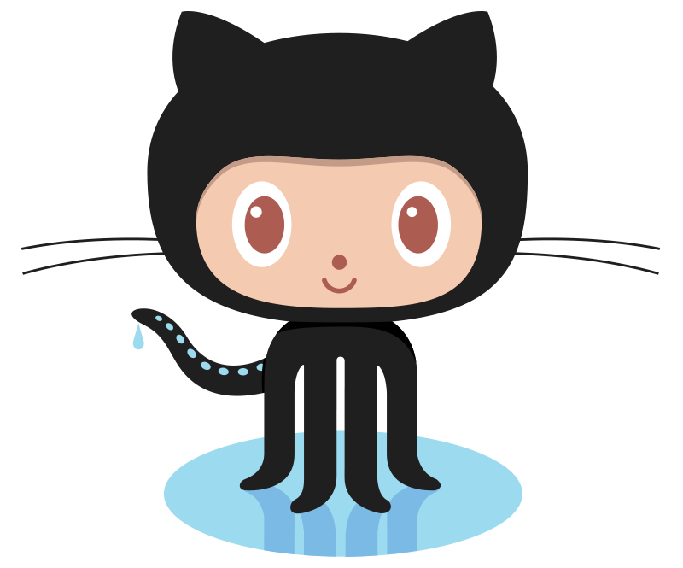
TimeStep Internship Skills Education
28 March 2022 Jess Johnson Steward Observatory
What is GitHub?
GitHub is a centralized, web-based Git repository hosting service. Conceptually it acts as a convenient, easily accessible central server whose job it is to facilitate the easy sharing of Git repositories. (And, interestingly enough, it is run by Microsoft.)
Octocat image used by permission of GitHub.

Slide 21
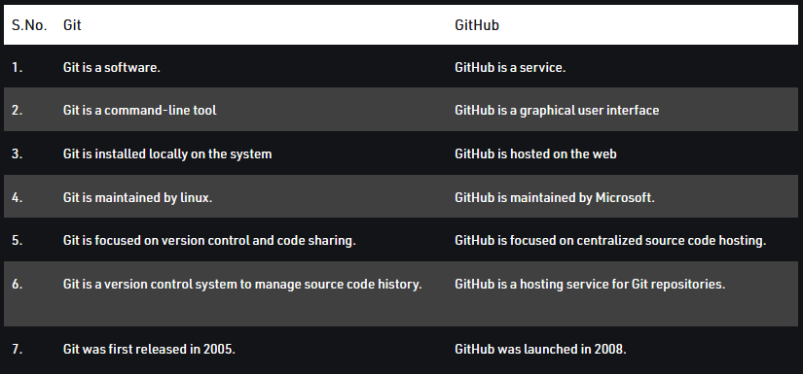
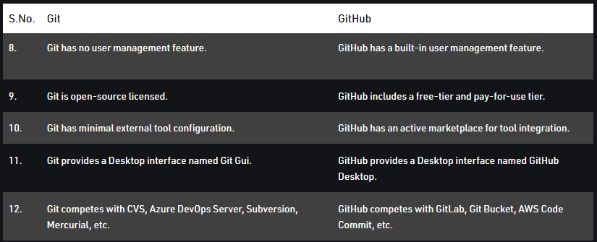
TimeStep Internship Skills Education
28 March 2022 Jess Johnson Steward Observatory
What is GitHub?
Table from https://www.geeksforgeeks.org/difference-between-git-and-github/

Slide 22
TimeStep Internship Skills Education
28 March 2022 Jess Johnson Steward Observatory
What is GitHub?
Before we start thinking about GitHub, we need to learn some Git…
Table from https://www.geeksforgeeks.org/difference-between-git-and-github/

Slide 23
TimeStep Internship Skills Education
28 March 2022 Jess Johnson Steward Observatory
References

Slide 24


TimeStep Internship Skills Education
28 March 2022 Jess Johnson Steward Observatory
References
Tom Preston-Werner
Co-Founder of GitHub
The Git Parable
https://tom.preston-werner.com/2009/05/19/the-git-parable.html
Ben Lynn
Computer Scientist & Engineer at Stanford
Git Magic
http://www-cs-students.stanford.edu/~blynn/gitmagic/

Slide 25
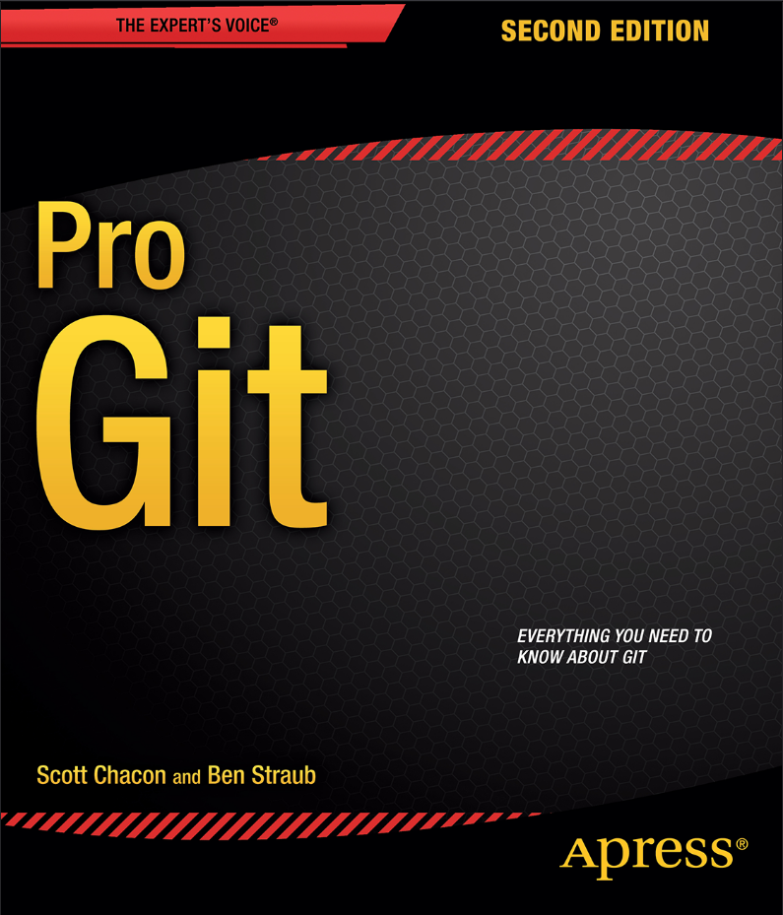
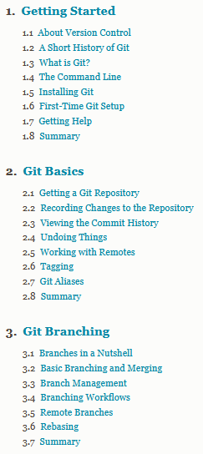
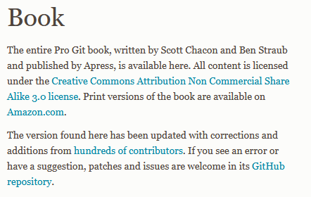
TimeStep Internship Skills Education
28 March 2022 Jess Johnson Steward Observatory
References
https://git-scm.com/book/en/v2

Slide 26
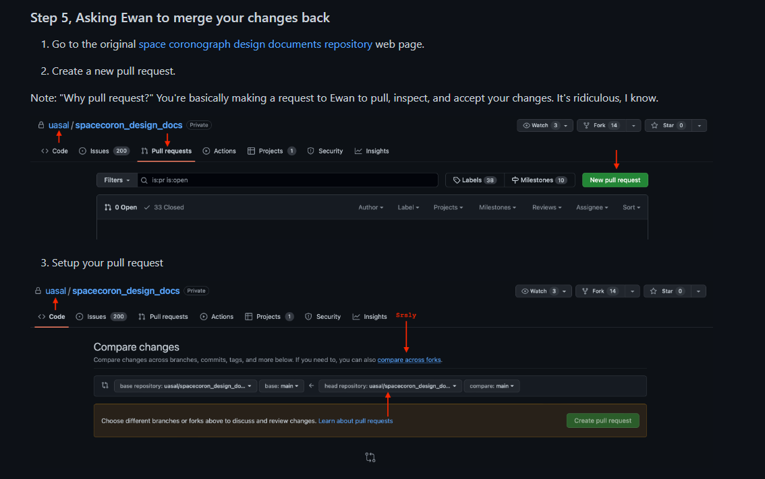
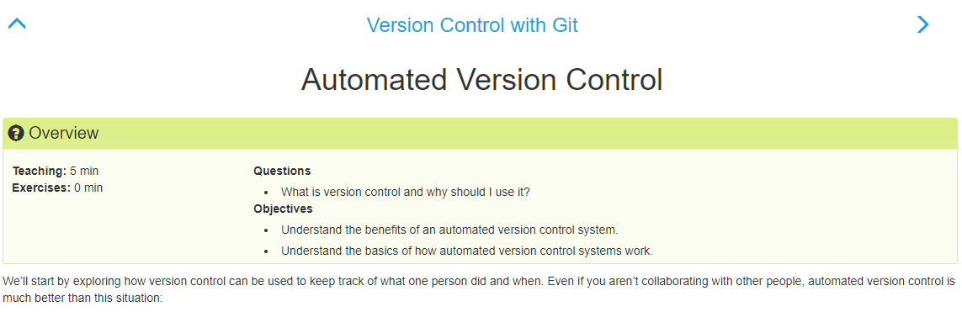
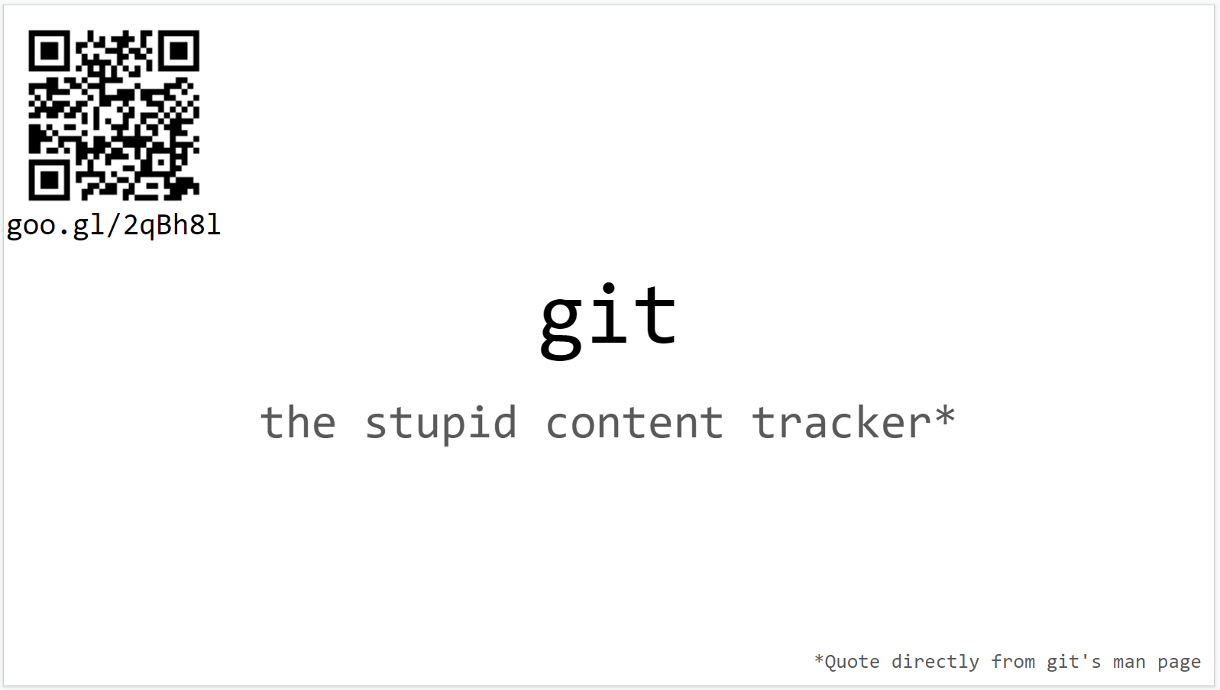
TimeStep Internship Skills Education
28 March 2022 Jess Johnson Steward Observatory
References
Version Control with Git (swcarpentry.github.io)
https://github.com/uasal/spacecoron_design_docs/
blob/main/sw_and_comp/git_startup.md
Git Tutorial - Google Slides

Slide 27
TimeStep Internship Skills Education
28 March 2022 Jess Johnson Steward Observatory
References
TIMESTEP-astro-research-handbook-public/Presentations/GitLectureOneReferences.md
Understanding Git
https://tinyurl.com/Git-Magic
https://tinyurl.com/The-Git-Parable
https://tinyurl.com/Git-Pro
Git Tutorials
https://tinyurl.com/Git-Version-Cntrol
https://tinyurl.com/Dr-Chans-Git
https://tinyurl.com/Sanford-Git
Installing Git
https://tinyurl.com/Git-Inst-Guide
https://tinyurl.com/Git-Win-Inst
https://gitforwindows.org/
https://tinyurl.com/Git-for-MacOS
Miscellaneous
https://tinyurl.com/Git-Com-CS
https://tinyurl.com/Git-Push-v-Pull
https://tinyurl.com/Git-SSH

Slide 28
TimeStep Internship Skills Education
28 March 2022 Jess Johnson Steward Observatory
Terminology

Slide 29
TimeStep Internship Skills Education
28 March 2022 Jess Johnson Steward Observatory
A Glossary of Git
Project (Dissambiguation): In Git, a project is a conceptual unit referring to exactly what you think it is. Creating a piece of software is a project, as is designing a space telescope. Large projects can be broken into smaller projects. In GitHub, however, a project has a specific meaning: it is an adaptable spreadsheet used to keep track of issues and pull requests. In this talk, Project has the first meaning.
Repository: The most basic, fundamental element of Git and GitHub. A snapshot of the folder where Git stores all of the files and documentation related to a project, as well as the full history of commits of a project, including information about who changed what, how, and when. It is basically composed of two parts:
.git Folder: The folder within the repository that holds all of the internal files that Git uses to track a project.
Working Tree: A directory structure containing all the project files and sub-directories exist.
Non-Bare vs Bare Repository: A Bare repository does not contain a working tree. Used in the central repository as part of the collaboration process.

Slide 30
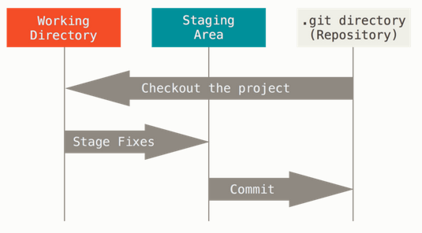
TimeStep Internship Skills Education
28 March 2022 Jess Johnson Steward Observatory
A Glossary of Git
Image from Pro Git, used in accordance with public license.

Slide 31
TimeStep Internship Skills Education
28 March 2022 Jess Johnson Steward Observatory
A Glossary of Git
The Three States:
Git has three main states that your files can reside in:
Modified: You have changed a file, but have not yet committed it to the database.
Staged: You have marked your modified file to be committed to the database.
Committed: Your modified file has been safely assimilated into the database.
The Three Main Sections of a Git Project:
The Working Directory/Tree: A single checkout (version) of a project. It is pulled out of the compressed files in the Git database and placed on the disk to be modified.
The Staging Area: The staging area is where modified files that will eventually be committed are stored. (It’s technically called the ‘index’, but ‘staging area’ makes conceptual sense).
The Git Directory: This is where Git stores the metadata and the database for the project.

Slide 32
TimeStep Internship Skills Education
28 March 2022 Jess Johnson Steward Observatory
A Glossary of Git

Checkout: Update files in the working directory to match the version in the database.
Repeat until Project is finished.



Modify: Make changes to files in your working directory.


Commit: Integrate the changes in the staging area into the database.


Add: Pick those changes that you want to be added to the database. This is done by adding them to the Staging area.
Image from Pro Git, used in accordance with public license.

Slide 33
TimeStep Internship Skills Education
28 March 2022 Jess Johnson Steward Observatory
A Glossary of Git
Branch: An independent line of development… a request for a new working directory, staging area, and project history. New commits are recorder in the history of the current branch, which results in a fork in the history of the project.
Fork: How Git gives each contributor a server-side repository. Every user has two Git repositories: a private local one, and a public server side one. Forks allow you to freely make changes to a project without affecting the original.
Clone: A copy of a repository that lives on your own machine. It is connected to the original in the sense that you can push your local changes to the remote.
Merge: Takes the changes from one branch, in the same repository, or from a fork and applies them to another. A Merge Conflict occurs when two users attempt to make changes to the same line of the same file, or when someone deletes a file that someone else has made a change to.

Slide 34
TimeStep Internship Skills Education
28 March 2022 Jess Johnson Steward Observatory
A Glossary of Git
Pull: As in, ‘pull in the changes’. The process of merging changes with a repository.
Pull Request: Proposed changes to a repository to be reviewed and accepted or rejected by the repositories’ collaborators.
Push: To send your committed changes to a remote repository.
Note:
The distinctions between ‘Push’ and ‘Pull’, and another related term, ‘Fetch’, can be subtle. There is a really good discussion of this on Stack Overflow:
“what-is-the-difference-between-git-push-and-git-pull”

Slide 35
TimeStep Internship Skills Education
28 March 2022 Jess Johnson Steward Observatory
Installation

Slide 36
TimeStep Internship Skills Education
28 March 2022 Jess Johnson Steward Observatory
Installation
General Info
Mac machines and Linux machines usually have Git installed already. Windows machines don’t. So first step is to check for an already existing Git installation. Open a terminal, or a Window’s command prompt. Type:
git version
This will return either a Git version number, or will return ‘unknown command’.
If you need to install, go to ‘Git Guides’ and read ‘Install Git’
https://github.com/git-guides/install-git

Slide 37
TimeStep Internship Skills Education
28 March 2022 Jess Johnson Steward Observatory
Installation
For Debian or Ubuntu Linux
Update your apt-get repositories:
sudo apt-get update
Install Git:
sudo apt-get install git-all
Verify with the terminal!

Slide 38
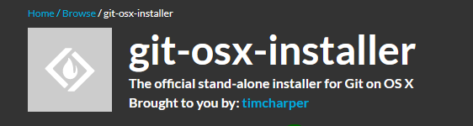
TimeStep Internship Skills Education
28 March 2022 Jess Johnson Steward Observatory
Installation
For MacOS
Install from the open-source ‘MacOS Git Installer’,
Available here:
=autoselect
Verify with the terminal!

Slide 39

TimeStep Internship Skills Education
28 March 2022 Jess Johnson Steward Observatory
Installation
For Windows
Install using Git Windows Installer
https://gitforwindows.org/
For windows installs, it is strongly recommended that you use the following install reference:
Verify with the terminal!

Slide 40
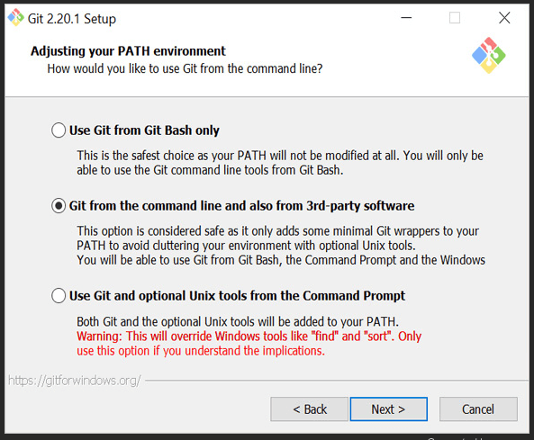
TimeStep Internship Skills Education
28 March 2022 Jess Johnson Steward Observatory
Installation

Slide 41
TimeStep Internship Skills Education
28 March 2022 Jess Johnson Steward Observatory
Configuration

Slide 42
TimeStep Internship Skills Education
28 March 2022 Jess Johnson Steward Observatory
Configuration
The Git Configuration Command:
git config
As with any other linux-type commands, this has help info associated with it:
git config –h
As does Git itself:
git -h

Slide 43
TimeStep Internship Skills Education
28 March 2022 Jess Johnson Steward Observatory
Configuration
Let’s configure some essential settings.
git config –global user.name “your name”
git config –global user.email “you@your.place”
Carriage returns can confuse Git:
git config –global core.autocrlf input (Mac/Linux)
git config –global core.autocrlf false (PC)

Slide 44
git config --global core.editor "nano -w"
git config --global core.editor "nano -w"
TimeStep Internship Skills Education
28 March 2022 Jess Johnson Steward Observatory
Configuration
Name the default branch.
git config –global init.defaultBranch main
git config –global user.email “you@your.place”
Select your default editor:
git config –global core.editor “nano –w”
Or:

Slide 45
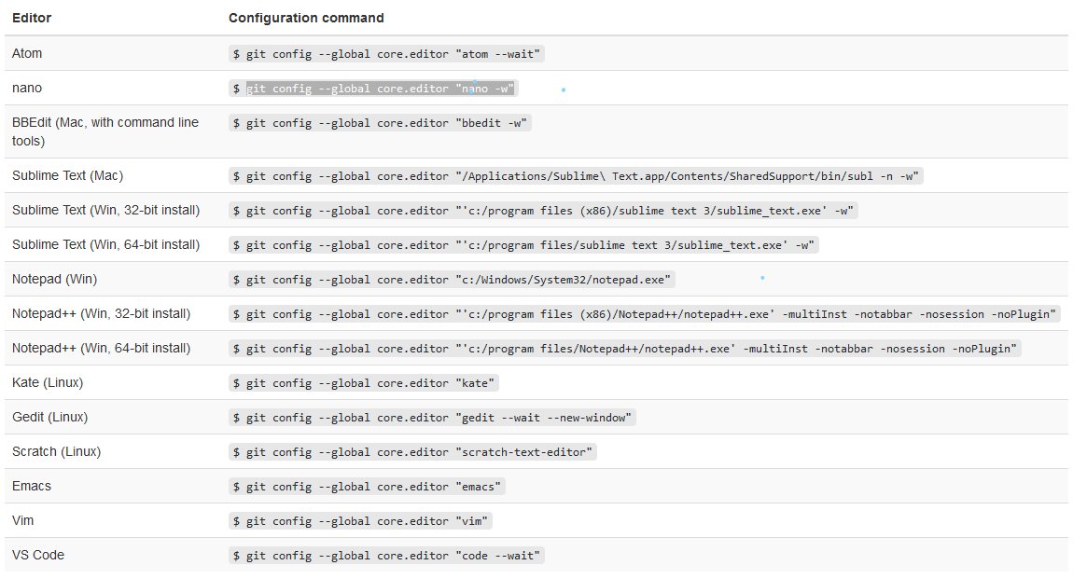
git config --global core.editor "nano -w"
git config --global core.editor "nano -w"
TimeStep Internship Skills Education
28 March 2022 Jess Johnson Steward Observatory
Configuration
Image from Version Control with Git Tutorial.

Slide 46
git config --global core.editor "nano -w"
git config --global core.editor "nano -w"
TimeStep Internship Skills Education
28 March 2022 Jess Johnson Steward Observatory
Configuration
To check your configuration:
git config –-list
git config –-list –-show-origin
Also, can check individual configuration key values:
git config <key>

Slide 47
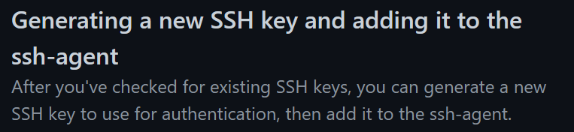
git config --global core.editor "nano -w"
git config --global core.editor "nano -w"
TimeStep Internship Skills Education
28 March 2022 Jess Johnson Steward Observatory
Configuration
One final Configuration Task:
Generating SSH Keys
https://docs.github.com/en/authentication/connecting-to-github-with-ssh/generating-a-new-ssh-key-and-adding-it-to-the-ssh-agent

Slide 48
TimeStep Internship Skills Education
28 March 2022
Part Two: Using
&
Jess Johnson
Steward Observatory
Git & Github logos used with permission

